Slide 1
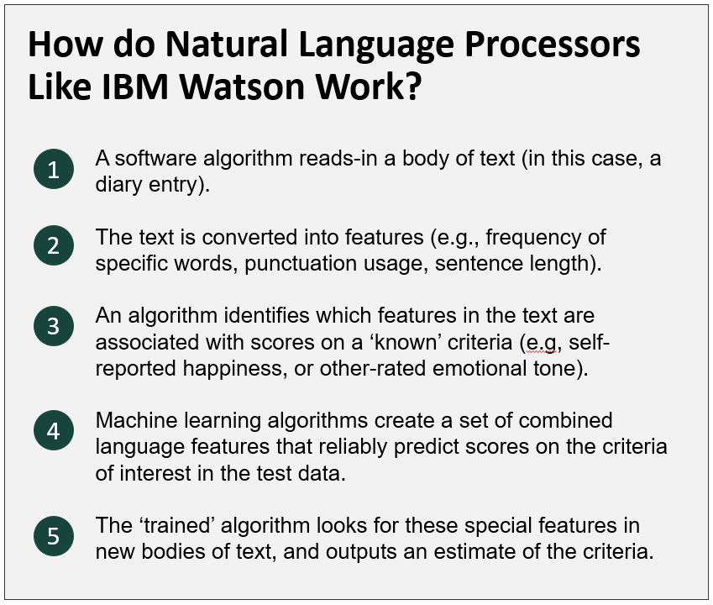

Climate Reconstruction: Modeling biological growth (detrending) and climate simultaneously properly accounts for uncertainty Flexible and explicit growth and climate sub-models Reconstructions highly dependent on climate relationship assumptions
Non-Cognitive Predictors of Student Success: A Predictive Validity Comparison Between Domestic and International Students
Non-Cognitive Predictors of Student Success: A Predictive Validity Comparison Between Domestic and International Students
Hierarchical Bayesian models for climate reconstruction and uncertainty using tree-ring data
Daniel J. Hocking djhocking@frostburg.edu
Laura G. Smith lsmit224@vols.utk.edu
AMMO BAR
Delete this and replace it with your…
Extra Graphs
Extra Correlation tables
Extra Figures
Extra nuance that you’re worried about leaving out.
Keep it messy! This section is just for you.
INTRODUCTION/Motivation
Tree growth is a result of allometric growth patterns, climate, and non-climatic environmental conditions
Hiding Uncertainty: Traditional dendroclimatological reconstructions occur in steps with removal of the biological growth and non-climatic variation prior to regression with climate
METHODS
N = ###,
Collected this
Tested with X statistical test
RESULTS
Graph or table with essential results only.
All the other correlations in the ammo bar.
DISCUSSION
“If this result actually generalized and I didn’t have to humbly disclaim the possibility of a thousand confounds and limitations, it would imply that….”
Keep font size as high above 28 as possible.
Take a picture to download the full paper
Notes:
Notes:
In Powerpoint, click View > Guides
Keep text within gutter guides.
Author list: Don’t split names onto two lines (e.g., “Jimmy [break] Smith”). If that happens, use a new line, unless you need the space. Bold the first names of anybody who’s presenting in person.
Intro/methods/result: Do not drop below font size 28, but if you have extra space, jack up the font size until the space is full.
Do not use color in the sidebars except in graphs/figures. It’ll pull attention from the center and slow interpretation for passersby.

Slide 2
Notes: 1. Correct fonts won’t load until you open this in PowerPoint (e.g., if you’re previewing this in your browser it’ll look uglier than it actually is). 2. Generate QR codes here: https://www.qrcode-monkey.com/

Slide 3
FAQ
How do I create a QR code?
https://www.qrcode-monkey.com/
https://www.qrstuff.com/
What if my intro/methods/results doesn’t fit in the silent bar?
If you’re trying to put so much into that bar that it doesn’t fit, they won’t have time to read it anyway. First try moving stuff to the ammo bar. Next, cut cut cut.
Instead of trying to fill space, you’re trying to conserve space.
What if I have a really important graph or picture?
Move the QR Code to the Silent Presenter, then put your graph/image in the middle.

